Slide 1
KIET Group of Institutions, Ghaziabad Department of Computer Applications (An ISO – 9001: 2015 Certified & ‘A’ Grade accredited Institution by NAAC) 2022-23 ODD SEM AI_LAB KCA-351
Department Of Computer Application
MCA 2nd Year(3rd sem)
Sbmited by – Kushagra tiwari

Slide 2
Topic –
Problem solving using AND-OR graph &
AO* Algorithm

Slide 3
definition
AND-OR graph
AND-OR graph is useful for representing the solution of problems
that can be solved by decomposing them into a set of smaller
problems, all of which must then be solved
AO* Algorithm is based on problem decomposition i.e. breakdown goal into simpler sub-goals. This decomposition generates generate arcs called AND arcs and several arcs may emerge from single node called OR arcs. That’s why called it AND-OR Graph. It is also called problem reduction search algorithm.

Slide 4
AND-or graph ALgorthm
1. Initialize the graph to the starting node.
2. Loop until the starting node is labeled solved pr until its cost goes
above FUTILITY.
3. Traverse the graph & set the nodes that are on the path & have not
yet been expanded & labeled as solved.

Slide 5
4. Pick one of these unexpanded nodes & expand it. Of there are no successor assign FUTILITY us the value of this node othervise, add it successor each of them computer f’ value (use only h’ and ignore g).
5. Change the f’ estimate of the newly expanded node to reflect the new information provided by its successor.

Slide 6
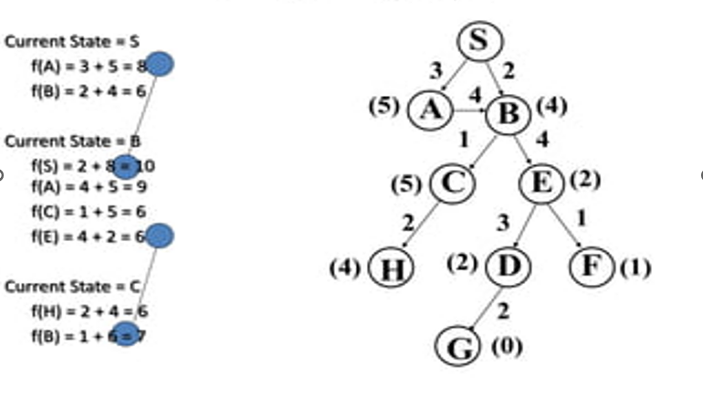
Example –

